Slide 1

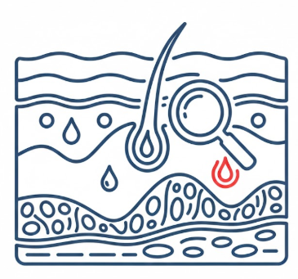
INTRODUCTION
Project Title: AI-Based Intelligent System for Skin Disease Detection and Healthcare Recommendation
Description: This project is an AI-based skin disease detection system that analyzes uploaded skin images using deep learning and provides disease predictions with confidence scores. Based on the user’s selected location, the system dynamically fetches nearby dermatology hospitals using real-time location services, helping users quickly find professional medical support. The application integrates machine learning, web technologies, and location-based healthcare assistance into a single user-friendly platform.
Domain: Artificial Intelligence

Slide 2






PROJECT OVERVIEW
Problem Statement : Current skin disease diagnostic methods are often slow and require expert intervention. This project aims to develop an AI-powered skin disease detection system to automatically classify skin diseases from uploaded images, provide early diagnosis, and help users connect with the right healthcare professionals.
Objectives
Target Users
Accurate AI-based skin disease prediction
General Public
Location-based dermatologist recommendation
Patients in remote areas
User-friendly interface
Healthcare support systems

Slide 3










TECHNOLOGY STACK
Frontend
Backend
Database
AI/ML Tools
React.js
Tailwind CSS
FastAPI
Python
postgre sql
supabase
CNN
skin clip
TensorFlow
Image preprocessing

Slide 4









CHALLENGES AND OVERCOMES
1. Low Confidence Scores due to Unbalanced Dataset
Challenge:
Some skin disease classes had very few training images, leading to low prediction confidence.
Solution:
Applied data augmentation techniques to
balance the dataset and improve model confidence.
3.Inaccurate Hospital Results Based on Location
Challenge:
Hospitals were not updating correctly when the user changed city or state.
Solution:
We decoupled skin analysis from location logic and implemented dynamic hospital fetching using city or state-based APIs, ensuring hospitals update automatically without re-analysis.
2. Poor Generalization Beyond Trained Classes
Challenge:
The model struggled to accurately detect skin conditions outside the trained categories.
Solution:
Improved feature extraction and used regularization techniques to help the
model generalize better to unseen skin patterns
4.API & Location Integration Issues
Challenge:
Geocoding failures and missing API keys caused empty hospital results.
Solution:
We properly configured environment variables, added fallback error handling, and validated API responses to ensure stable location-based data retrieval.

Slide 5

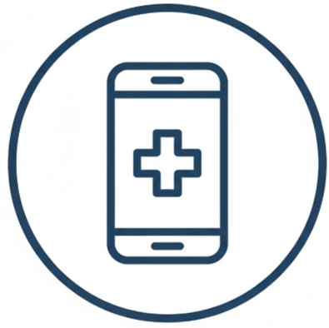


FUTURE SCOPE
The system can be expanded by training the model on a larger and more diverse dataset to detect additional skin conditions with higher accuracy and reliability.
Developing a mobile application will make the system more accessible, allowing users to capture images and receive predictions anytime and anywhere.
Integrating a consultation module will enable users to directly connect with dermatologists for expert advice, improving diagnosis validation and treatment guidance.

Slide 6


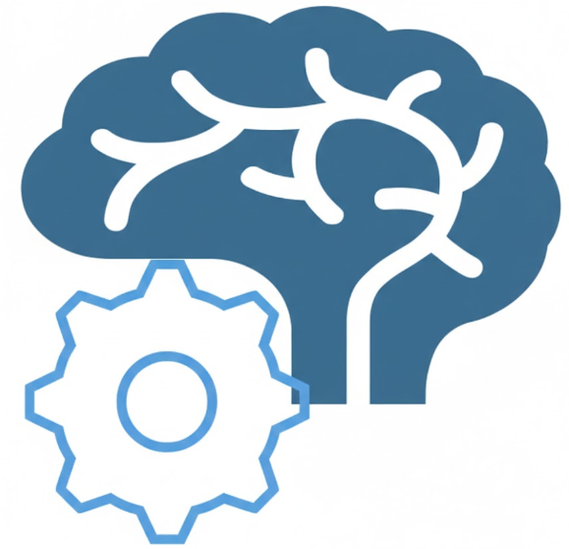
CONCLUSION
OVERALL PROJECT SUMMARY
KEY ACHIEVEMENTS
LEARNING OUTCOMES
Developed an AI-based skin disease detection system with hospital recommendation support.
The system analyzes skin images and provides disease prediction with confidence scores.
Location-based hospital suggestions help users seek medical assistance quickly.
Successfully implemented deep learning for skin disease classification.
Integrated image processing, prediction, and hospital search in one platform.
Improved model reliability using data augmentation techniques.
Gained hands-on experience with AI/ML model development.
Learned full-stack integration of AI models with a web application.
Improved understanding of healthcare-focused AI solutions and real-world challenges.

Slide 7

THANK
YOU

